Slide 2
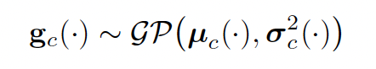
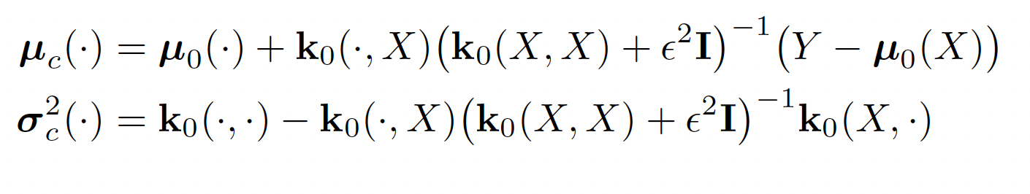
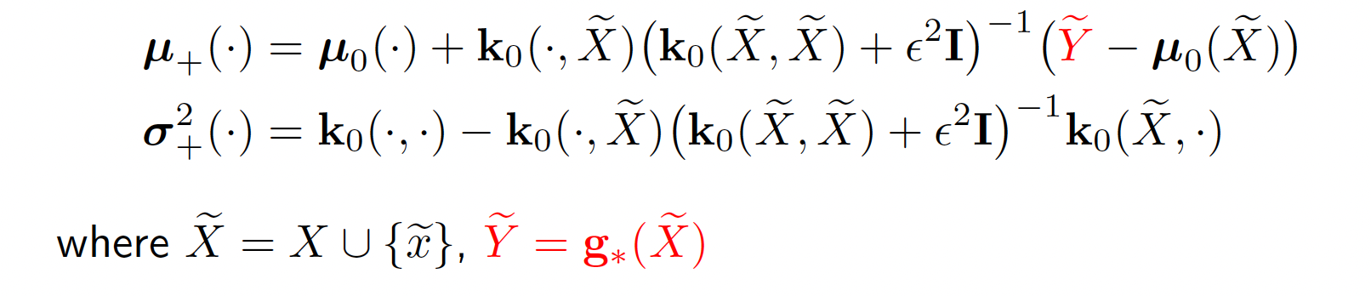

Brief background: Gaussian Process Surrogate Modeling
We have an optimal control problem where our dynamics depend on a variable that is expensive to compute,
called g(x). We construct a Gaussian Process surrogate model to approximate the parameter g based on a small
number of refined samples
We can update the Gaussian Process model in a Bayesian manner as shown below. Note that computing the
updated variance does not require us to refine the surrogate at the new point. ($μ_{c}$is the current GP mean, and $μ_{+}$
Is the updated GP mean after point $\tilde{x}$ is refined).

Slide 3
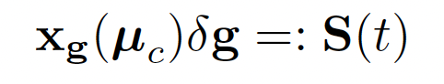
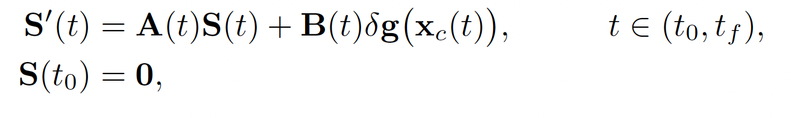
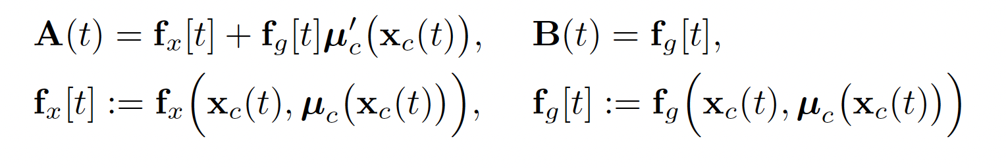
Brief background: Sensitivity LQOCP
We construct an LQOCP optimal control problem to approximate the sensitivity of the optimal control solution
to refinement at a particular set of new refinement points. We first define the sensitivity operator.
Which solves the following IVP

Slide 4

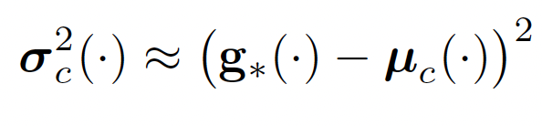
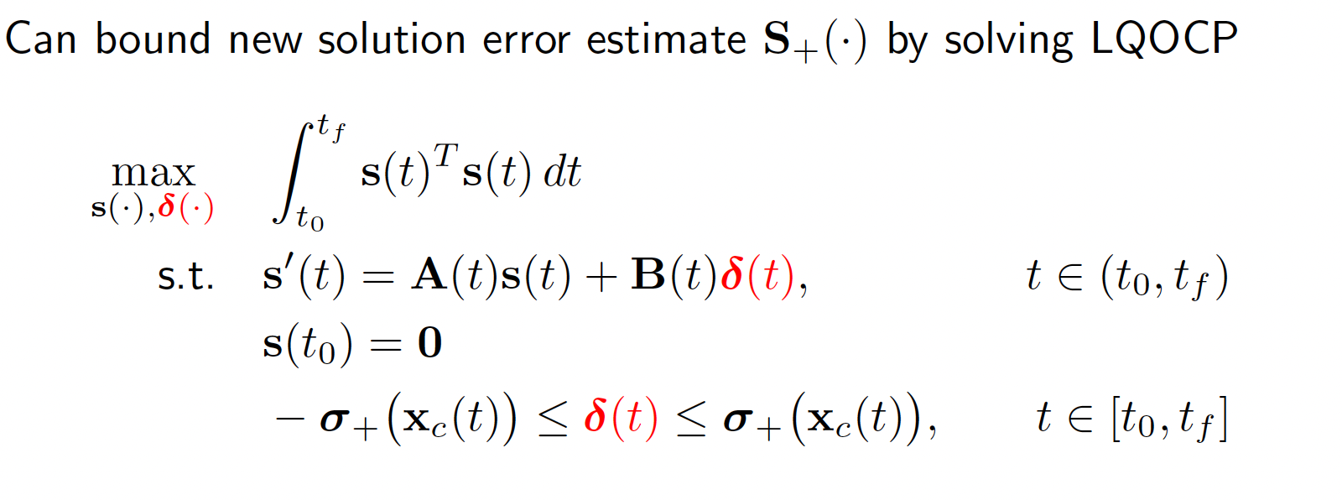
Brief background: Sensitivity LQOCP
We take a linear approximation of the error in the open loop solution
We postulate that the error is bounded by 1 SD in the Gaussian Process (we interpret g* as the realization of
a Gaussian RV with mean and variance defined by the GP)
We now solve the LQOCP. The idea is that we are finding the delta(t) perturbation of the GP mean that results in the
greatest deviation of the trajectory, while assuming that the perturbation delta(t) is bounded by 1 SD. The point that
minimizes the L2-norm of S(t) will be refined.

Slide 5
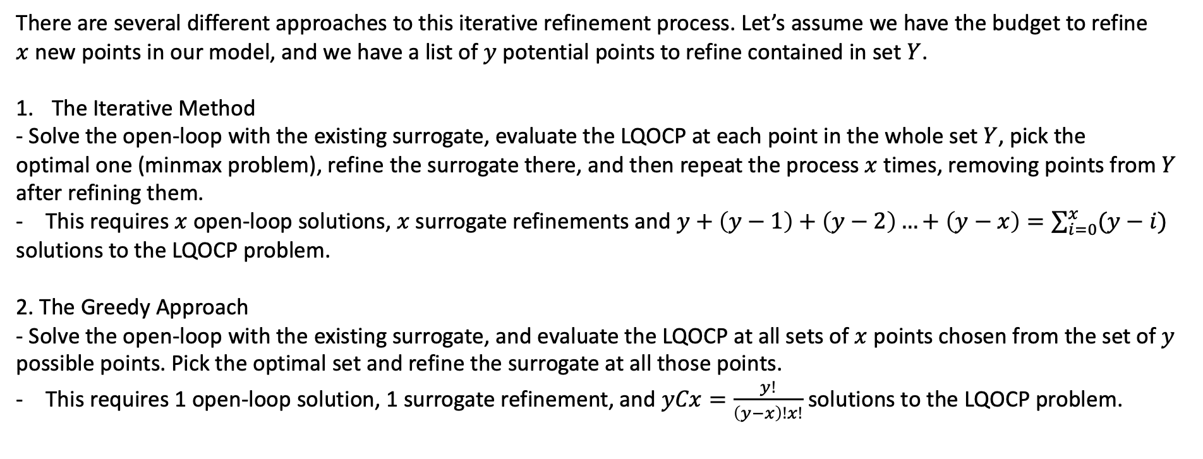
Optimizing the Refinement Process
There are several different approaches to this iterative refinement process. Let’s assume we have the budget to refine
$x$ new points in our model, and we have a list of $y$ potential points to refine contained in set $Y$.
The Iterative Method
- Solve the open-loop with the existing surrogate, evaluate the LQOCP at each point in the whole set$Y$, pick the
optimal one (minmax problem), refine the surrogate there, and then repeat the process $x$ times, removing points from $Y$
after refining them.
This requires $x$ open-loop solutions, $x$surrogate refinements and $y+\left(y−1\right)+\left(y−2\right)…+\left(y−x\right)=\sum_{i=0}^{x}{(y−i)}$
solutions to the LQOCP problem.
2. The Greedy Approach
- Solve the open-loop with the existing surrogate, and evaluate the LQOCP at all sets of $x$ points chosen from the set of $y$
possible points. Pick the optimal set and refine the surrogate at all those points.
This requires 1 open-loop solution, 1 surrogate refinement, and $yCx=\frac{y!}{\left(y−x\right)!x!}$ solutions to the LQOCP problem.

Slide 6
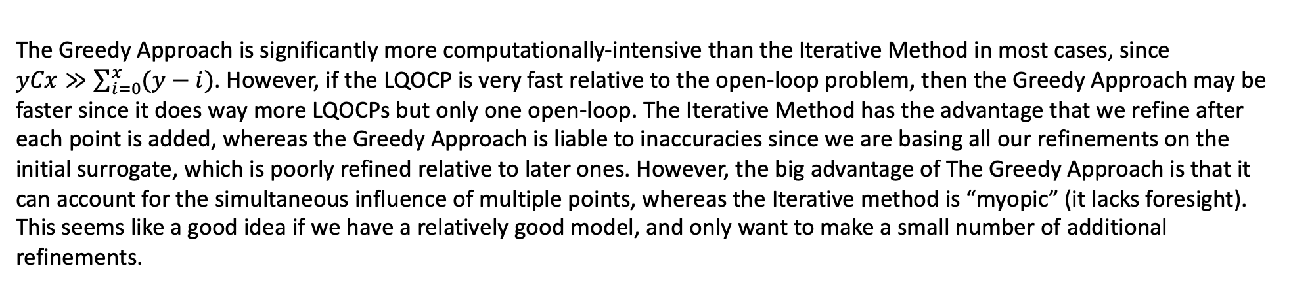
The Greedy Approach is significantly more computationally-intensive than the Iterative Method in most cases, since
$yCx≫\sum_{i=0}^{x}{(y−i)}$. However, if the LQOCP is very fast relative to the open-loop problem, then the Greedy Approach may be
faster since it does way more LQOCPs but only one open-loop. The Iterative Method has the advantage that we refine after
each point is added, whereas the Greedy Approach is liable to inaccuracies since we are basing all our refinements on the
initial surrogate, which is poorly refined relative to later ones. However, the big advantage of The Greedy Approach is that it can account for the simultaneous influence of multiple points, whereas the Iterative method is “myopic” (it lacks foresight).
This seems like a good idea if we have a relatively good model, and only want to make a small number of additional refinements.

Slide 7
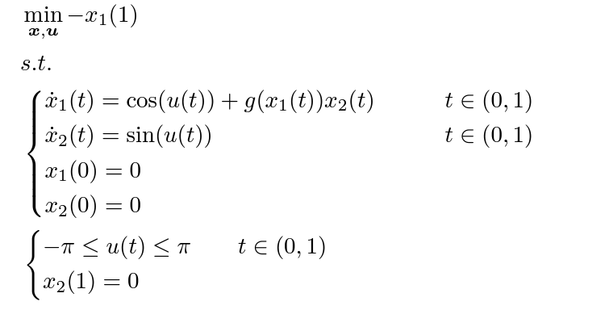
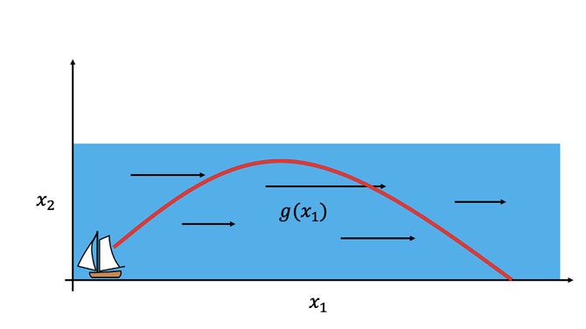
Testing both strategies on the Zermelo Problem
For our purposes we can let g(x) = 19*(x-0.45)^3 – 3*(x-0.1)^2, defined on 0<x<1
Let’s start with a simple one-point-refinement to illustrate the procedure. Assume we have a surrogate model which is refined at one point x = 0.5, and we want to select a new point from this list: [0,0.1,0.2,0.3,0.4,0.5,0.6,0.7,0.8,0.9,1] to refine.

Slide 8
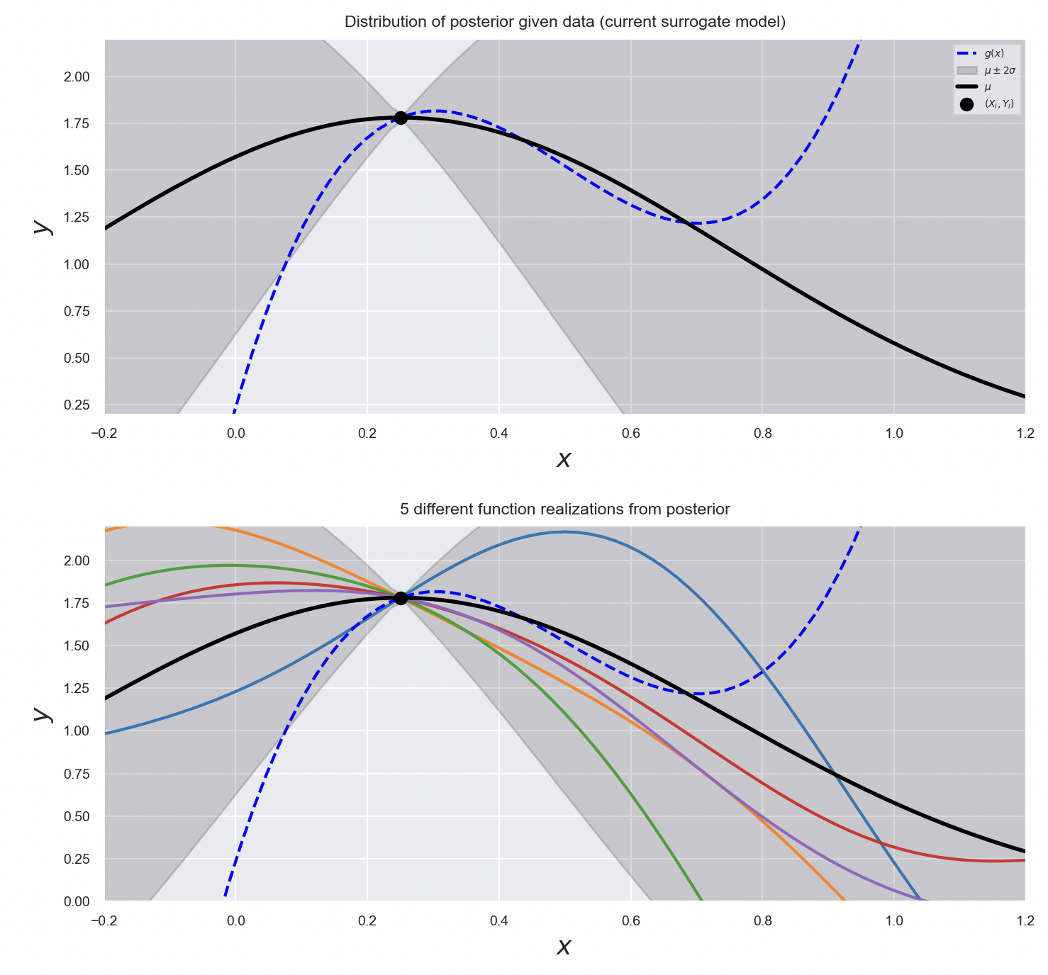
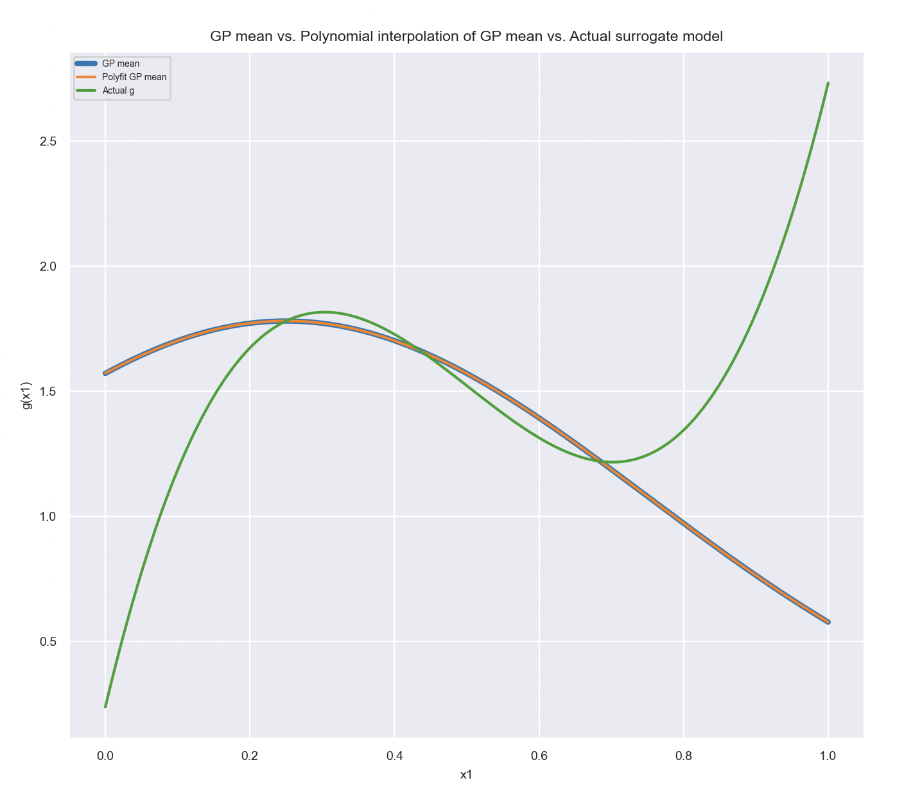
The initial GP surrogate looks like this. (One refined point). This is obviously a very poor surrogate. Note that we have to approximate the surrogate with a high-degree polynomial to interface with Pyomo

Slide 9
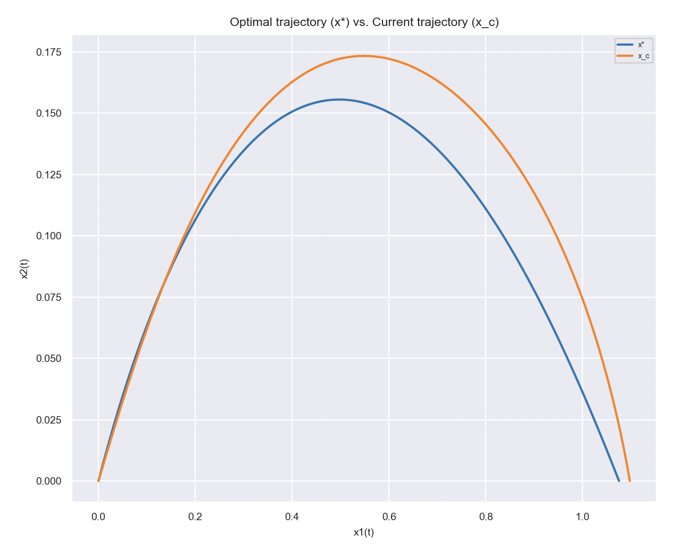
We solve the open-loop problem with the surrogate (and with the actual function g(x) to compare). For the initial surrogate, the trajectories look like this. Our goal is to find the refinement point that will best improve the accuracy of the trajectory x_c.

Slide 10
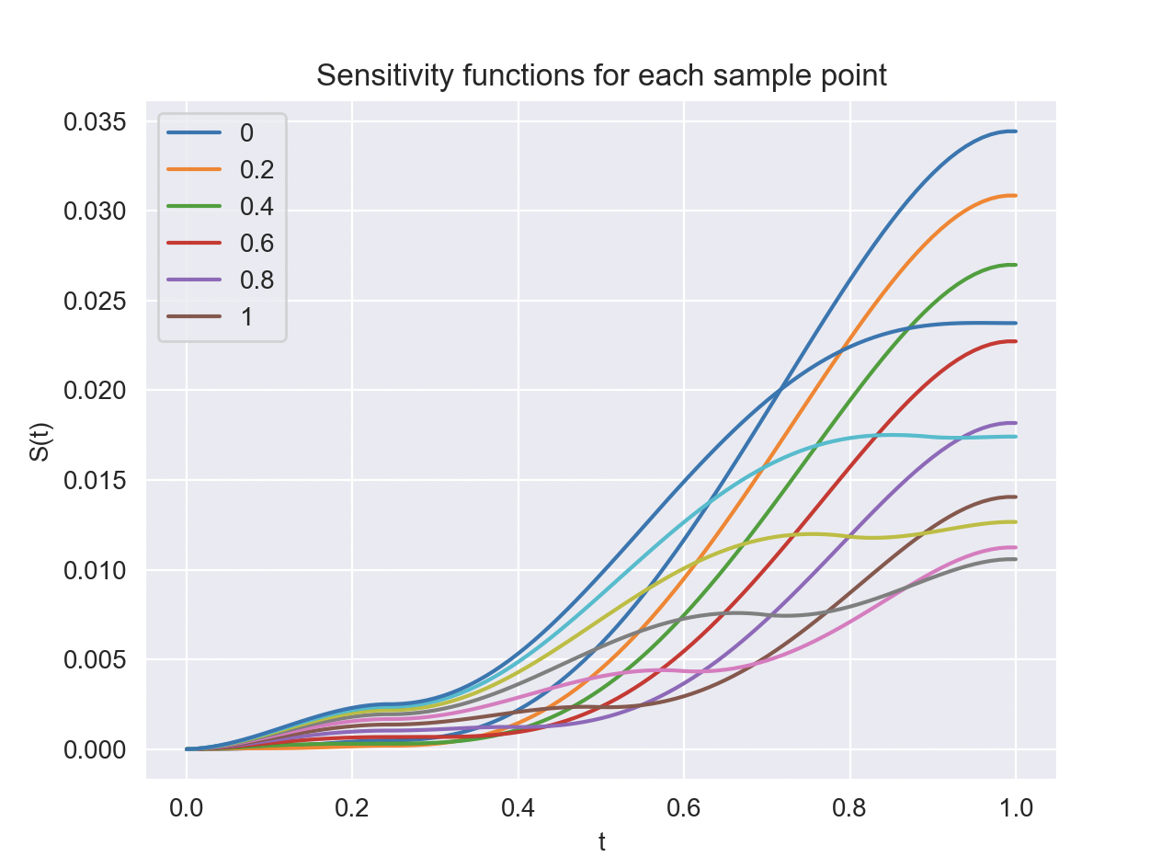
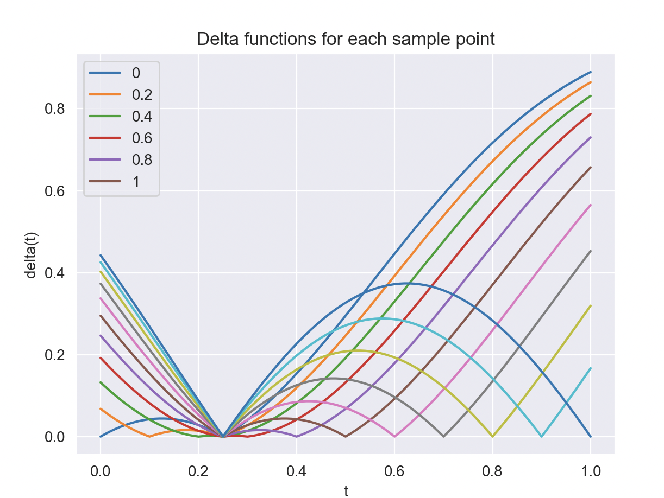
We solve the LQOCP problem. The sensitivity functions and delta functions are shown here. Note that all the delta functions seem maximized along the bound of 1 SD. This makes sense intuitively since we are trying to induce the greatest deviation in the output solution. As explained previously we choose the point that minimizes the L2-norm of S(t)

Slide 11
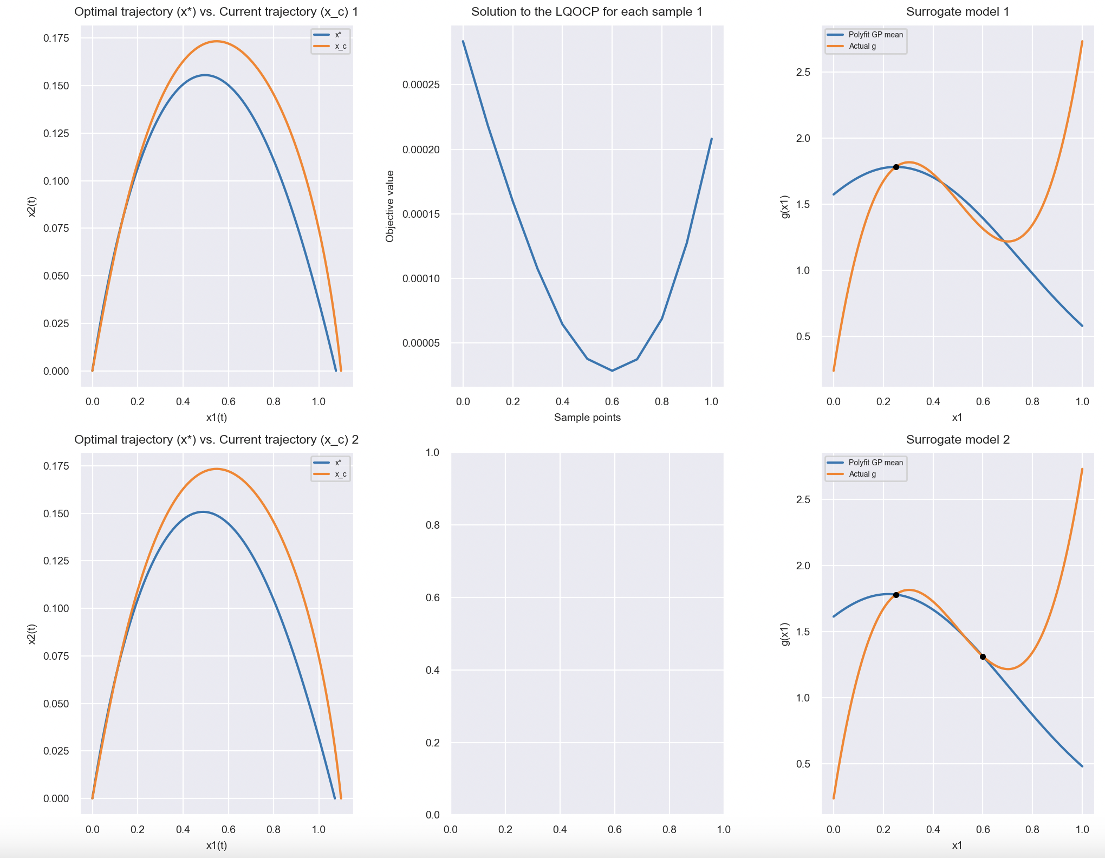
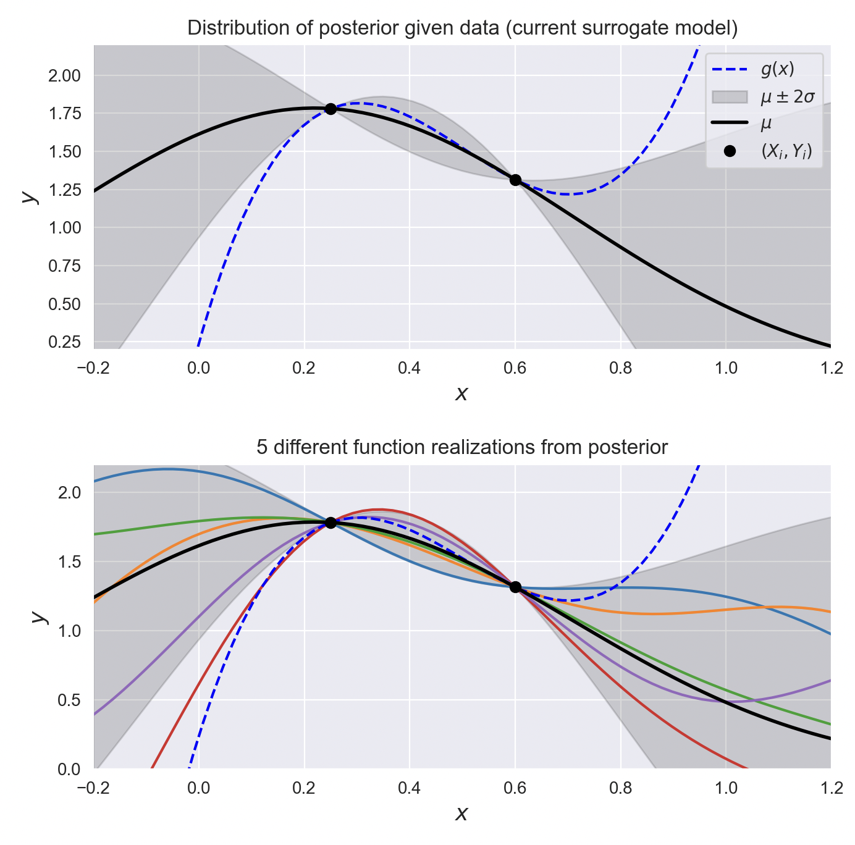
We find that the L2-norm of S(t) is minimized at x=0.6, so we refine there. In this case the solution is improved only marginally, since our initial GP was already close to the real value at x=0.6 by coincidence.

Slide 12
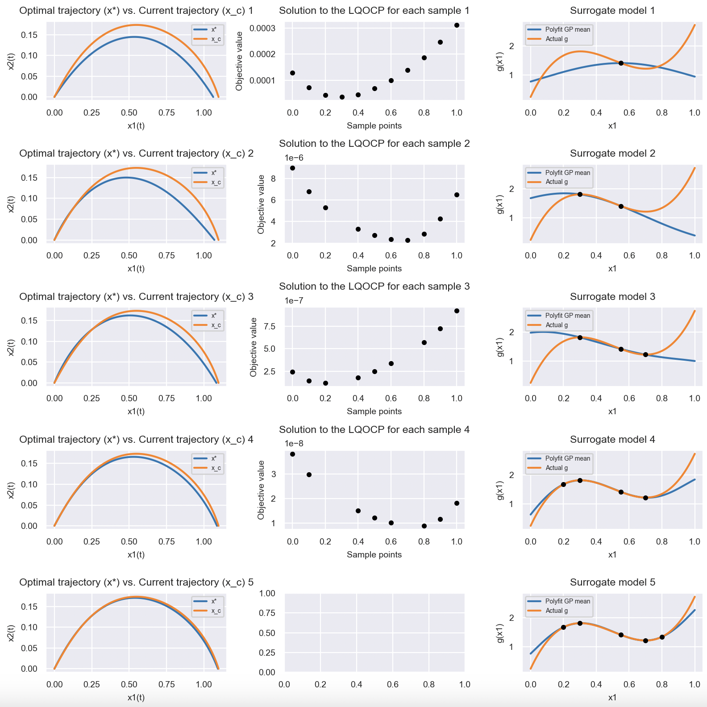
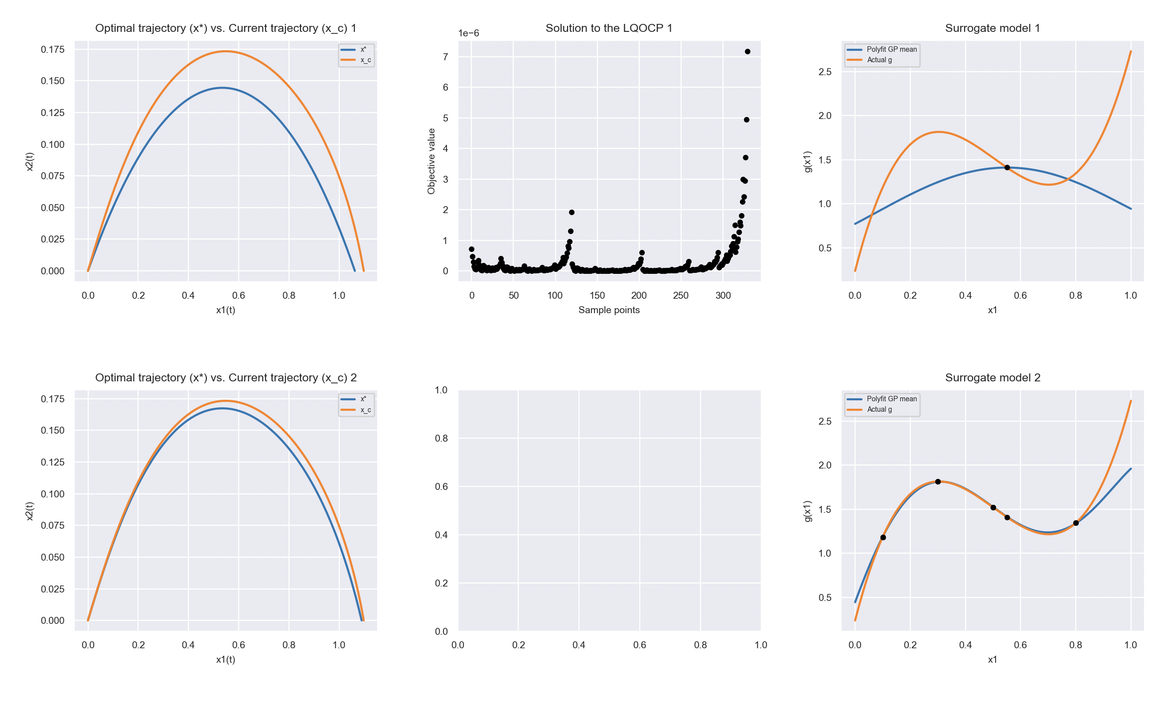
Now we can move onto refinement of multiple points, a more realistic scenario. Assume we have a surrogate model which is refined at one point x = 0.55, and we want to select 4 new points from this list: [0,0.1,0.2,0.3,0.4,0.5,0.6,0.7,0.8,0.9,1] to refine.
Iterative Method
Greedy Approach
In this case, the iterative method refines the points [0.3,0.7,0.2,0.8] in that order, and the greedy approach refines [0.1,0.3,0.5,0.8].

Slide 13
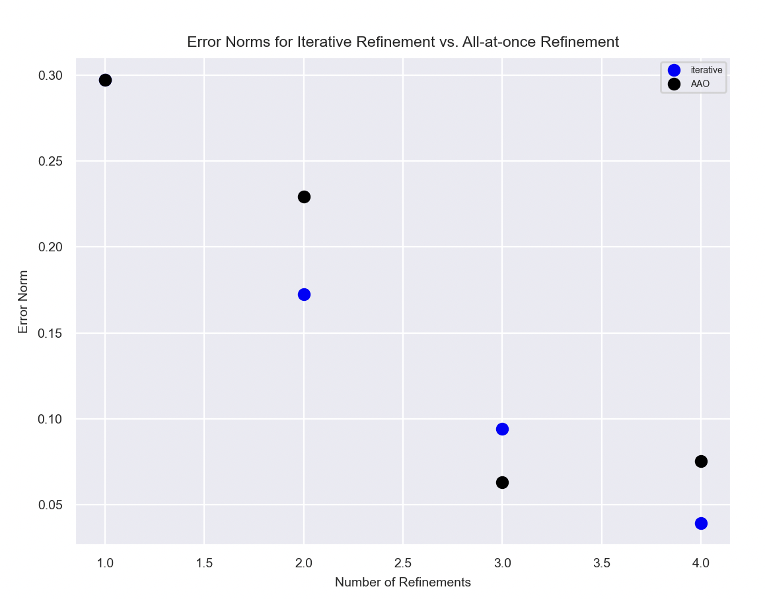

Using the same surrogate model which is refined at one point x = 0.55, and potential refinement points [0,0.1,0.2,0.3,0.4,0.5,0.6,0.7,0.8,0.9,1], We can try 1, 2, 3, and 4 refinements and compare iterative and all-at-once procedures. In this case I am using a norm defined below:
$Error Norm=\left\|\left\langle \left\|{x1}_{∗}−{x1}_{c}\right\|,\left\|{x2}_{∗}−{x2}_{c}\right\|\right\rangle \right\|$, where $\left\langle {x1}_{∗}, {x2}_{∗}\right\rangle$ is the actual open-loop trajectory, and $\left\langle {x1}_{c},{x2}_{c}\right\rangle$ is the one computed with the surrogate model. Note that for 1 refinement, both methods compute the same solution (degenerate case).

Slide 14
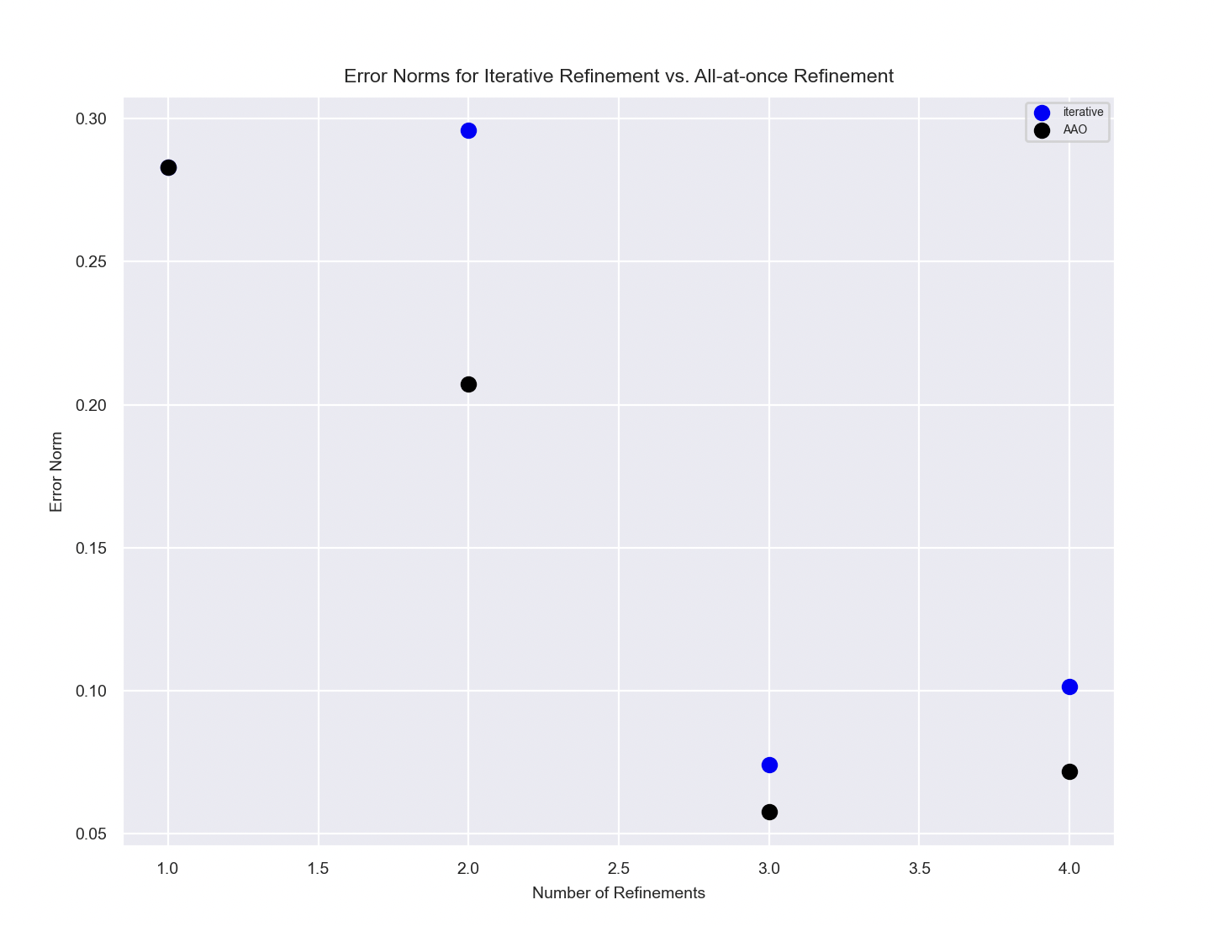
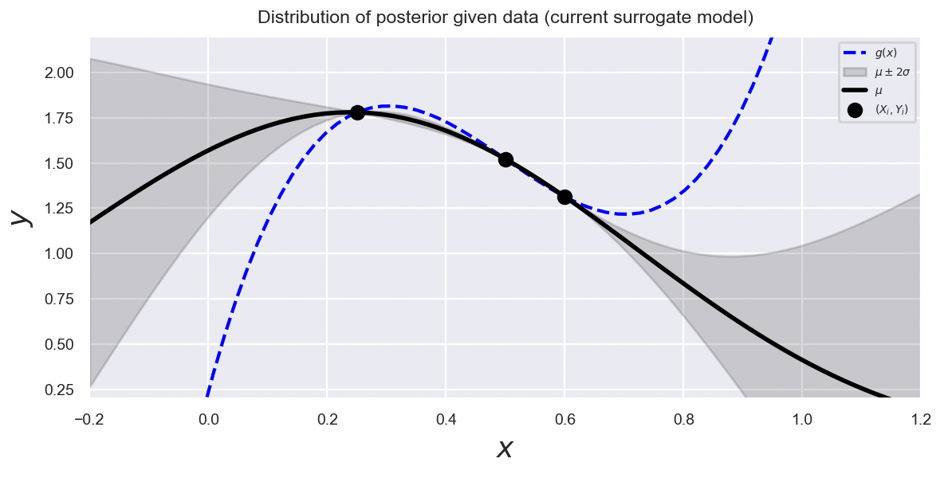
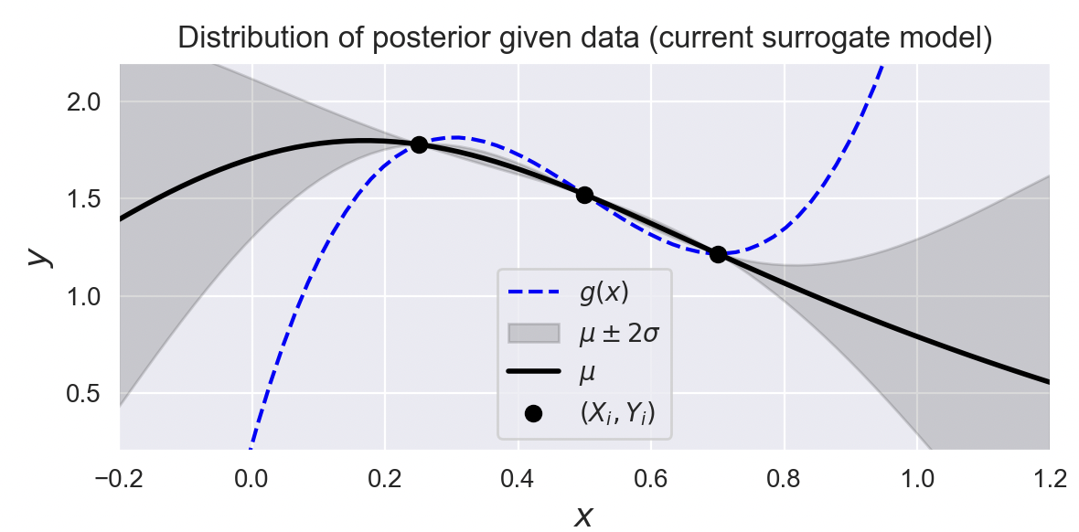
Now, let’s change the initially refined point to x = 0.25. In this case AAO does better on all trials, especially for 2 refinements. This makes sense. For 2 refinements, Iterative refines [0.6,0.5] in that order, and AAO refines [0.5,0.7]. The iterative scheme is myopic, and it tries to reduce error as much as possible with the first point, without considering the influence of subsequent points. Thus, it ends up with a suboptimal solution. In contrast, AAO “sees” how the two points influence each other and is able to “spread out” the 2 points to optimally cover the uncertain region.
2 Refinements: Iterative
2 Refinements: AAO

Slide 15
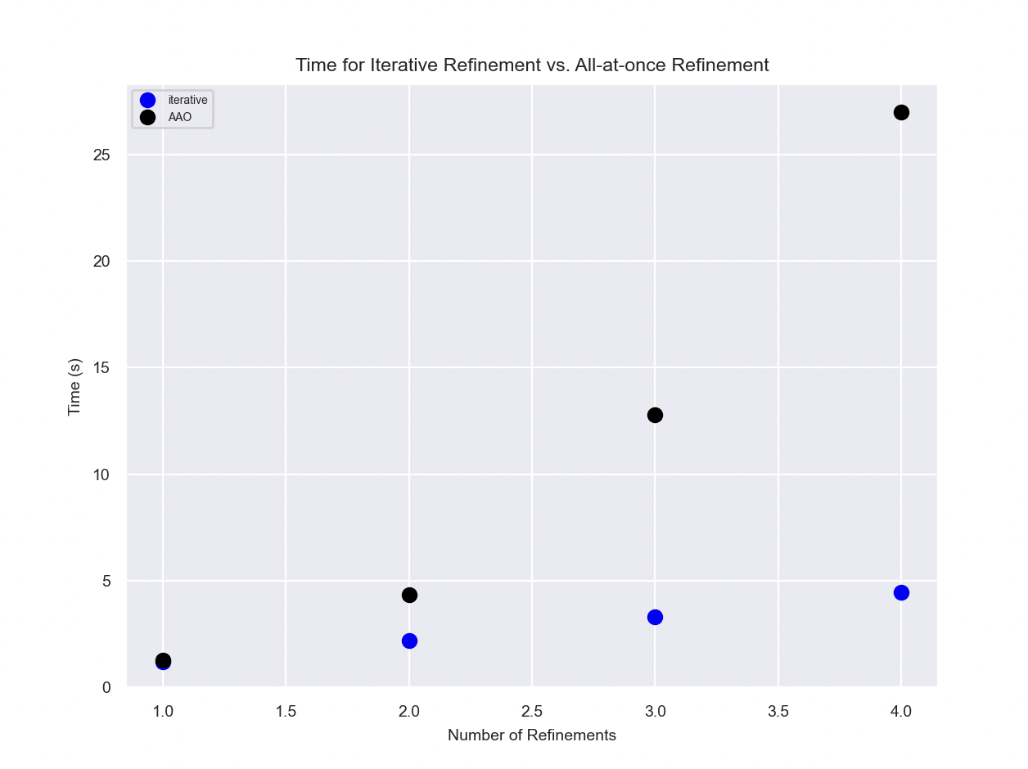
Now we compare the runtime for Iterative vs. AAO. As predicted, AAO is way slower due to the rapid growth of yCx as a function of y.

Slide 16
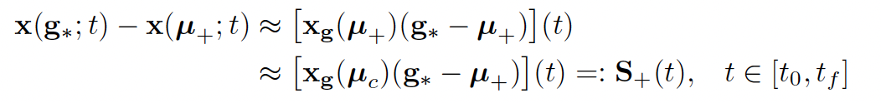


The LQOCP approach is dependent on this assumption:
We are assuming that the second Frechet derivative of x, $x_{gg}$, is sufficiently small that we can assume:
$$x_{g}\left(μ_{+}\right)≈x_{g}\left(μ_{c}\right)$$
This breaks down if we refine too many points at once, since x changes significantly.

